Slide 1
Agile principles and methodologies

Slide 2
What is Agile?
Agile has revolutionized software development.
Today, agile principles underpin all agile development practices and methods.
Agile is based on 4 key values and 12 key principles.
Applied correctly, the 12 agile principles help overcome many of the problems experienced on traditional projects such as late delivery and quality problems.

Slide 3
Why was the Agile methodology developed?
In the late ’90s, both workers and clients were frustrated with the existing project management methodologies like the Waterfall.
The disparity between delivered products and the client’s requirements were huge.
Delays in the project were common and many projects were either cancelled or left the clients unsatisfied with the performance.
There was a consensus that companies are focusing on the wrong things and wasting their time and efforts.
There was a need for an innovative, modern methodology such as Agile methodology that can quickly adapt to the changing circumstances and give certain freedom to the project teams in order to increase their efficiency and performance.

Slide 4
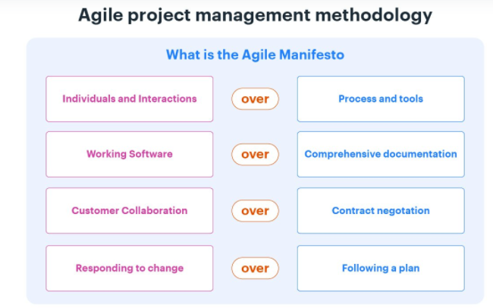
4 values of Agile Manifesto

Slide 5
1. Individuals and interactions over processes and tools
This value of the Agile manifesto focuses on giving importance to communication with the clients.
There are several things a client may want to ask.
It is the responsibility of the project team members to ensure that all questions and suggestions of the clients are promptly dealt with.

Slide 6
2. Working product over comprehensive documentation
This value of the Agile manifesto focuses on the first and foremost duty of the project team is completing the final deliverables as identified by the customers.
In the past, more focus used to be on proper documentation of every aspect of the project.
This was done for several times at the expense of the delay in the final product.

Slide 7
3. Customer collaboration over contract negotiation
The Waterfall approach or Traditional methodologies only allow customers to negotiate before and after the project.
This used to result in wastage of both time and resources.
Agile principles require customers to be involved in all phases of the project.
If the customers are kept in the loop during the development process, project team members can ensure that the final product meets all the requirements of the client

Slide 8
4. Responding to change over following a plan
Agile method is contrary to the traditional management methodologies of the past.
Agile values are against using elaborate plans before the start of the project and continue sticking to them no matter what is the result.
Circumstances change and sometimes customers demand extra features in the final product that may change the project scope.
In these cases, project managers and their teams must adapt quickly in order to deliver a quality product and ensure 100% customer satisfaction.

Slide 9
12 Principles of Agile Manifesto
Customer satisfaction through continuous delivery of the product
Divide large chunks of work into smaller and achievable tasks for quicker completion and easier integration of changes
Adhere to the decided timeframe for the delivery of a working product
All stakeholders must frequently collaborate to ensure that the project is going in the correct direction
Create a supportive environment to motivate team members and encouraging them to get the job done
Prefer face-to-face communication over any other methods
Working software is the primary measure of progress
Try to maintain a constant pace of development.
Maintain the quality of the product by paying attention to technical details
Maintain simplicity
Promote self-organization in the team
Regularly reflect on your performance for continuous improvement

Slide 10
1. Customer satisfaction through continuous delivery of the product
In the case of traditional management methodologies, customers get to see the product only after completion and when several tests and quality checks have been performed.
This not only keeps the customers in dark but also makes it problematic for the team members to introduce any changes in the product.
In order to keep the customers happy, it’s important to continuously engage them with a working version of the product.
Show small increments when every sprint planning and make changes as required.

Slide 11
2. Divide large chunks of work into smaller and achievable tasks for quicker completion and easier integration of changes
Handling a huge and complex task would be both time and energy-consuming while managing project tasks.
A better way is to divide the big task into smaller parts that can be easily completed.
The customers would always be kept in the loop and it would be easier for the team members to identify potential bottlenecks and handle any potential delays.

Slide 12
3. Adhere to the decided timeframe for the delivery of a working product
The Agile philosophy favors a smaller time frame and delivers working software frequently.
This iterative process requires team members to continuously improve their performance.

Slide 13
4. All stakeholders must frequently collaborate to ensure that the project is going in the correct direction
A major problem associated with traditional project management methodologies is that the project stakeholders are often oblivious to the development stages of the project.
The Agile principles encourage all stakeholders to remain involved in all stages of the project development in order to ensure constant feedback and a valuable end product.

Slide 14
5. Create a supportive environment to motivate team members and encouraging them to get the job done
It is the responsibility of the project manager to create a motivating environment and support where members are not afraid to voice their opinions and give suggestions for the betterment of the team’s performance.
Giving the team members the confidence and motivating them would cause their overall performance to improve significantly which will ultimately leads to the better outcome for the project.

Slide 15
6. Prefer face-to-face communication over other methods
In the Agile manifesto, a lot of importance is given to effective communication between the involved parties.
For effective communication, methods like memos and email are not preferred and more importance is given to face-to-face communication.
This is now easier because of the advances in communication technologies.
All stakeholders can now have a meeting through video conferencing rather than coming to the office for a short meeting.

Slide 16
7. Working software is the primary measure of progress
The only factor to measure success is the delivery of a working product that satisfies the customer requirement.
Before Agile, there were many measures of success and that results a drop in the quality of the final product.

Slide 17
8. Try to maintain a constant pace of development
A repeatable and iterative pattern should be established where sustainable development of the project takes place at a constant rate.
This prevents the team members from being overwhelmed and over-stressed, while the project keeps on progressing at an acceptable rate.

Slide 18
9. Maintain the quality of the product by paying attention to technical details
Providing value to the customer is the primary objective of any Agile team.
It’s extremely important to have a multi-skilled team that can handle all the technical aspects of the project and provides the opportunity for continuous improvement.

Slide 19
10. Maintain simplicity
In each time box, the tasks at hand should be the main focus of all team members.
Too much planning and adding extra features to the product should be avoided during the development.

Slide 20
11. Promote self-organization in the team
A self-organized team with decision-making powers would simply perform better because the responsibility of satisfying the customers will on the team members, rather than a single project manager.

Slide 21
12. Regularly reflect on your performance for continuous improvement
Agile methodologies stand on the concept of iteration, where teams learn from their past mistakes and try to continuously improve their performance.
Project managers should promote sessions where the whole team reflects (reveal) on their performance and discuss ways to improve their technical and management skills.

Slide 22
Getting started with Agile
Although Agile methodologies are not too complicated, you still needed some help from experts in the past.
But now, you can shift to Agile principles and values by using different software available in the market.
Example:-
Kissflow Project is one of those applications which is intuitive for those who do not know much about the Agile Methodology.
It is a free project management software and offers a simple interface and Kanban boards to organize all your tasks.
You can add team members, collaborate with them on the board, and track progress easily by using this software.

